Slide 1
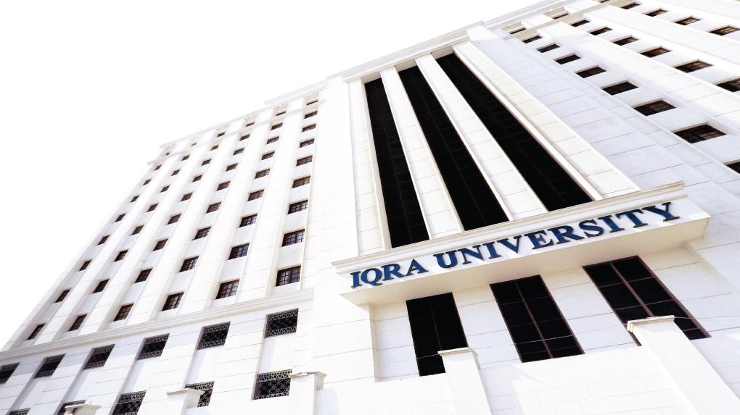

Mathematical Logic and Reasoning
LECTURE 3
Adapted from :
https://www.genrica.com/vustuff/MTH202/MTH202_handouts_1_45.pdf

Slide 2
Learning Outcomes
After completing this lecture satisfactorily, a student will:
• Be able to construct simple mathematical proofs and possess
the ability to verify them.
Have substantial experience to comprehend formal logical
arguments.
• Be skillful in expressing mathematical properties formally via
the formal language of propositional logic and predicate logic.

Slide 3
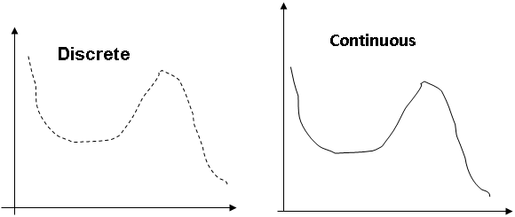

Slide 7
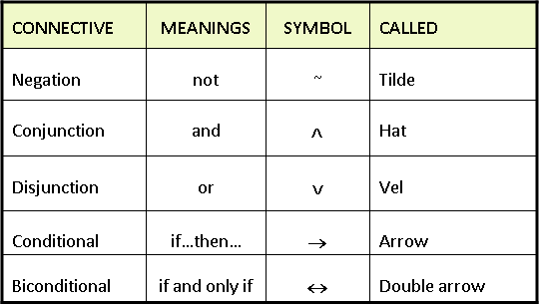
Tide

Slide 10
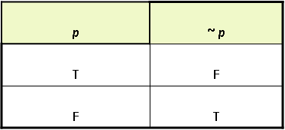

Slide 11
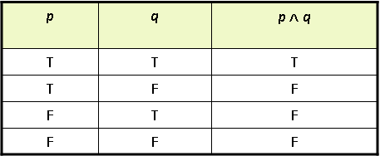

Slide 12
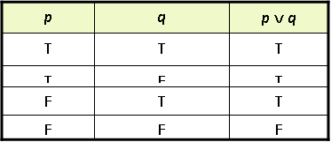

Slide 13
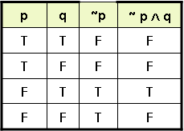

Slide 14
Review Questions
Can you explain Compound Statements
Write down from symbolic to English Ttranslation

Slide 15
Thank you

